Slide 1
Patience and Perseverance in Daily Life
One of the most emotional and painful calamities is the loss of a love one. The death of parents, children, spouses, relatives, friends is sometime hard to comprehend
1. Patience when loosing Love ones.
Once the prophet passed by a woman who have been weeping over the grave of her son. The prophet advised her to calm down and accept Allah’s will. The woman did not recognize the prophet and said, “Leave me alone, you don’t know how hard his death was on me!” The prophet withdrew politely, but said to her, “true patience when you observe it as the first shock hits.”

Slide 2
Umm Salmah lost her dear husband and felt deeply sad. “She then saidAllah spares a great reward for the one who acts patiently when he loses a love one. The prophet said, (Hadeeth Qudsi) “If I test my servant with the loss of his love one and he demonstrates patience, I will grant him Jannah.
: I heard Rasoolullah Say: Who ever is put through a trial and says:

Slide 3
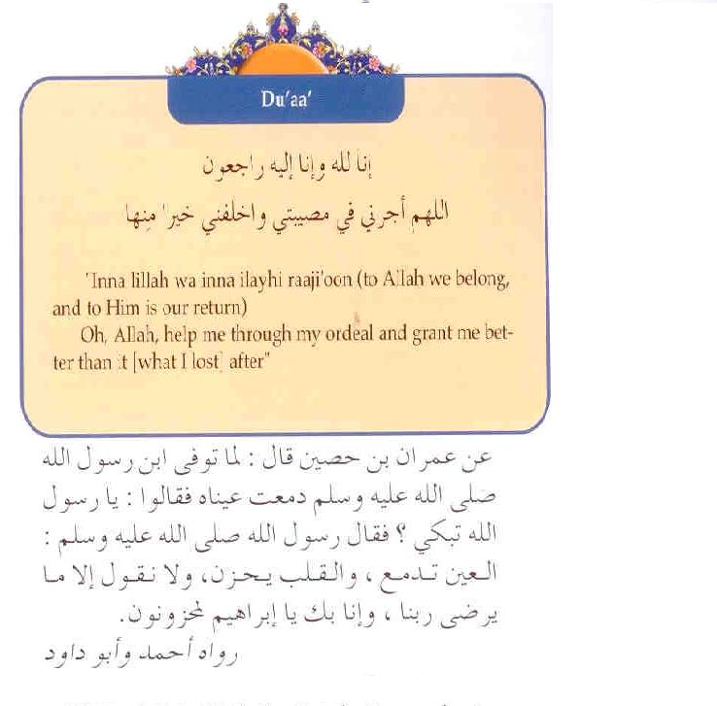

Slide 4
Except Allah helped him through his ordeal and gave him better than it after. She said: “So when Abu Salmah (her husband)died, I said what I was told to say by Messenger of Allah and Allah granted me better than him, the Prophet of Allah himself!”

Slide 5
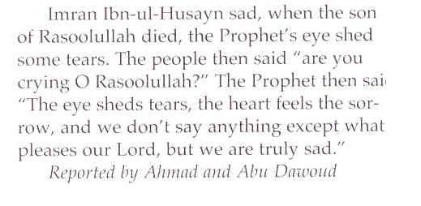
Prophet Muhammad lost his son Ibrahim and wept:

Slide 6
2. Patience With Property Loss Or Damage
Allah decorated this this life with many beautiful things to make mankind happy but faithful. They are required to use the blessing in the best possible way, without becoming passionately attached to them. They should realize that whatever people acquire here will remain here, and they will have to account for their use of these blessings in the Day of Judgment.
Those who understand that everything is a gift from Allah and show gratitude to Him will be rewarded, while those forget the Day of Judgment and seize the blessing with greed, will suffer disappointment.

Slide 7
The Qur’an say:
زُيِّنَ لِلنَّاسِ حُبُّ الشَّهَوَاتِ مِنَ النِّسَاءِ وَالْبَنِينَ وَالْقَنَاطِيرِ الْمُقَنْطَرَةِ مِنَ الذَّهَبِ وَالْفِضَّةِ وَالْخَيْلِ الْمُسَوَّمَةِ وَالْأَنْعَامِ وَالْحَرْثِ ۗ ذَٰلِكَ مَتَاعُ الْحَيَاةِ الدُّنْيَا ۖ وَاللَّهُ عِنْدَهُ حُسْنُ الْمَآبِ
Beautified for men is the love of things they covet; women, children, much of gold and silver (wealth), branded beautiful horses, cattle and well-tilled land. This is the pleasure of the present world's life; but Allah has the excellent return (Paradise with flowing rivers) with Him.
The faithful use these blessings in the best possible way They know that the possessions and goods are created to test them. Knowing that the blessings of this world are temporary and the home of the real blessings is the hereafter, they have no worldly ambitions.

Slide 8
Since they have neither ambition nor passion for worldly goods, they show patience weather times are good or bad. When they lose their property, they do not sink into sorrow or worry, instead they know that Allah is testing their faith and patience. Therefore they do not become distraught if their houses or gardens are destroyed, or business end up with bankrupt. Despite all of these trials, they live in comfort provided by the knowledge that Allah will ease their burdens, clear their way and reward patience with better in the hereafter. Such test reveal the difference between the faithful who show patience for the sake of Allah and those who pursue worldly pleasure only and forget about the afterlife. The believers do not grieve or despair when they lose their property, for their only intention is use everything they possess physically and spiritually to worship Allah and earn His pleasure.

Slide 9
In other words, they have already devoted these possessions to Allah In return for their devotion, they receive the following reward:
وَلَنَبْلُوَنَّكُمْ بِشَيْءٍ مِنَ الْخَوْفِ وَالْجُوعِ وَنَقْص
اَِينَ الْأَمْوَالِ وَالْأَنْفُسِ وَالثَّمَرَاتِ ۗ وَبَشِّرِ الصَّابِرِينَ
الَّذِينَ إِذَا أَصَابَتْهُمْ مُصِيبَةٌ قَالُوا إِنَّا لِلَّهِ وَإِنَّا إِلَيْهِ رَاجِعُونَأُولَٰئِكَ عَلَيْهِمْ صَلَوَاتٌ مِنْ رَبِّهِمْ وَرَحْمَةٌ ۖ وَأُولَٰئِكَ هُمُ الْمُهْتَدُونََِ

Slide 10
وَلَنَبْلُوَنَّكُمْ بِشَيْءٍ مِنَ الْخَوْفِ وَالْجُوعِ وَنَقْصٍ مِنَ الْأَمْوَالِ وَالْأَنْفُسِ وَالثَّمَرَاتِ ۗ وَبَشِّرِ الصَّابِرِينَ
And We will test you with a certain amount of fear and hunger and loss of property and lives and fruits; and give good news to the patient,
. الَّذِينَ إِذَا أَصَابَتْهُمْ مُصِيبَةٌ قَالُوا إِنَّا لِلَّهِ وَإِنَّا إِلَيْهِ رَاجِعُون .
Who, when afflicted with calamity, say: "Truly! To Allah we belong and truly, to Him we shall return.“
أُولَٰئِكَ عَلَيْهِمْ صَلَوَاتٌ مِنْ رَبِّهِمْ وَرَحْمَةٌ ۖ وَأُولَٰئِكَ هُمُ الْمُهْتَدُونَ
.
They are those on whom are the Salawât (i.e. who are blessed and will be forgiven) from their Lord, and (they are those who) receive His Mercy, and it is they who are the guided-ones.

Slide 11
3. Patience During hunger or Poverty
Allah may also test the people with poverty and hunger. Allah makes the test by sending the same test to people in a wide variety of forms and in unexpected ways. Those who have true faith and devotion are prepared to face these difficulties in in all of their forms on relying on the power of their faith and submission to Allah.
Disbelievers forget that only Allah gives the countless favors to them in this world, but they show Him no gratitude. In fact , if even one blessing is removed, they rebel against Allah and show ingratitude. One can find such examples on regular basis.

Slide 12
They ignore the fact that their houses, cars, clothes, foods, and drinks were Allah’s gifts to them, they believe that all such thing belonged to them alone. They do not put their trust in Allah and thus turn a beneficial test against themselves.
On the other hand, true believers remain pleased with their Lord either they are rich or poor, hungry or fed, thus they will be rewarded with Allah’s mercy Allah says in Surat-ul-Baqarah

Slide 13
أَمْ حَسِبْتُمْ أَنْ تَدْخُلُوا الْجَنَّةَ وَلَمَّا يَأْتِكُمْ مَثَلُ الَّذِينَ خَلَوْا مِنْ قَبْلِكُمْ ۖ مَسَّتْهُمُ الْبَأْسَاءُ وَالضَّرَّاءُ وَزُلْزِلُوا حَتَّىٰ يَقُولَ الرَّسُولُ وَالَّذِينَ آمَنُوا مَعَهُ مَتَىٰ نَصْرُ اللَّهِ ۗ أَلَا إِنَّ نَصْرَ اللَّهِ ق!
Or think you that you will enter Paradise without such (trials) as came to those who passed away before you? They were afflicted with severe poverty and ailments and were so shaken that even the Messenger and those who believed along with him said, "When (will come) the Help of Allah?" Yes! Certainly, the Help of Allah is near!
Allah tells us that those people were afflicted with poverty and illness and sought refuge in His help and are patient and meet such a test with good behavior, whatever the circumstances, His help is very near at hand. We know this because He promises that while testing the faithful, He will ease their burden. Allah says in surat-ul-Inshirah

Slide 14
فَإِنَّ مَعَ الْعُسْرِ يُسْرًا
Verily, along with every hardship is relief,
وإِنَّ مَعَ الْعُسْرِعسرا
Verily, along with hardship is relief(i.e. there is one hardship with two reliefs, so one hardship cannot overcome two reliefs)
Prophet Muhammad (P.B .U. H) preferred to live as poor man. A’ishah once said, “two or more month used to pass without being able to cook food.” Most of the Sahaba led a very modest and poor life, but they stood fast on their faith and devotion to Allah. In order to win Allah’s approval, they remained patient on His path despite thirst, poverty, and intolerable hunger, and continued to struggle along with our Prophet. Allah says about those patient believers in Surat-ut-Tawbah:

Slide 15
ذَٰلِكَ بِأَنَّهُمْ لَا يُصِيبُهُمْ ظَمَأٌ وَلَا نَصَبٌ وَلَا مَخْمَصَةٌ فِي سَبِيلِ اللَّهِ وَلَا يَطَئُونَ مَوْطِئًا يَغِيظُ الْكُفَّارَ وَلَا يَنَالُونَ مِنْ عَدُوٍّ نَيْلًا إِلَّا كُتِبَ لَهُمْ بِهِ عَمَلٌ صَالِحٌ ۚ إِنَّ اللَّهَ لَا يُضِيعُ أَجْرَ الْمُحْسِنِينَ
That is because they suffer neither thirst nor fatigue, nor hunger in the Cause of Allah, nor they take any step to raise the anger of disbelievers nor inflict any injury upon an enemy but is written to their credit as a deed of righteousness. Surely, Allah wastes not the reward of the Muhsinûn.
Allah announces that the patience displayed by the tested believers will be rewarded, and non of their good acts will be overlooked, on Day of Judgment. He also proclaims His mercy toward the faithful by describing as those “who (He) has preserved them from hunger and secured them from fear” (Surah Quraysh,

Slide 16
Selected Story
“Abu Hurayrah narrated: The people used to say, Abu Hurayra narrates too many narrations.” In fact I used to keep close to Allah,s Messenger and was satisfied with what filled my stomach. I ate no leavened bread and dressed no decorated striped clothes, and never did a man or woman serve me, and I often used to press my belly against gravel because of hunger, I used to ask a man to recite a Qur’anic verse to me although I knew it, so that he would take to his home and feed me.
And the most generous of all the people to the poor was Ja’far bin Abi Talib.He used to take us to his home and offer us what was available therein. He would even offer us an empty folded leather container (of butter) which we would split and lick whatever was in it.

Slide 17
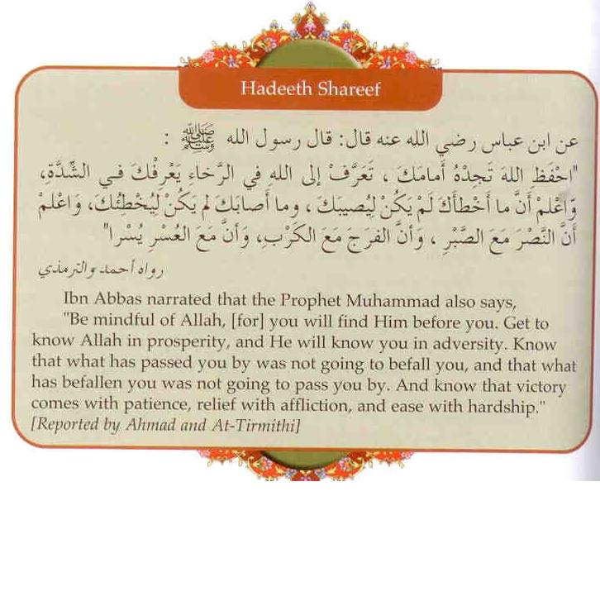
Hadeeth Shareef

Slide 18
4. Patience During Illness
True believers are usually patient and steadfast in cases of illness, accidents and injury, because of their deep faith in Allah and the hereafter. They hope that in Paradise Allah will re-create them in such a fine from that it cannot be compared with their worldly bodies. Their hope for a great reward causes them to become steadfast and patience when facing medical calamities. They always remember that whatever they have suffered in short life will entitle them to a great reward in the eternal afterlife.

Slide 19
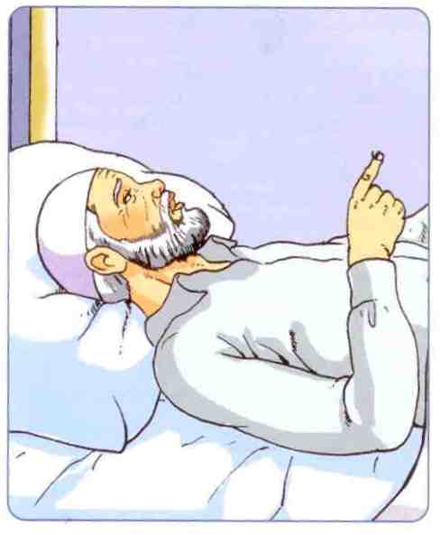
وَإِذَا مَرِضْتُ فَهُوَ يَشْفِينِ

Slide 20
Prophet Ibrahim is quoted in Surat-ush-Shu’araa saying:
وَإِذَا مَرِضْتُ فَهُوَ يَشْفِين
"And when I am ill, it is He who cures me;
Like Prophet Ibrahim believers also know that Allah creates both illness and the cure, so there is hope when they fall ill. They are grateful to Allah for being healthy many years, they continue to behave gratefully even when they are ill .
Disbelievers cannot show patience during serious illness, so they sink into great hopelessness, depression and grief. For example, those with crippled limbs say that would rather die than live with a handicap; some even try to commit suicide. They think living thus makes life meaningless. Even if they don’t commit suicide , they develop a very unpleasant personality and try to create problems for those around them. Such people can avert such event, if they put their trust in Allah .

Slide 21
They may hope that Allah will give them brand new body in paradise. But if they fail to trust in Allah, their present life and future life in the Hereafter will be destroyed. They will rewarded with Hell.
The behavior of those who live the Qur’anic’s morality is completely different. When they are injured, lose an organ, or experience a similar disaster, their behavior does not change. Knowing that they are being tested and end result will be positive, They remain patient and do their best to earn Allah’s pleasure. Those who turn away from Allah while they are ill or injured are not aware of their great error, for only Allah can heal or rescue them from illness.

Slide 22
Doctors, medicines, and treatment can be provided with Allah’s permission. Understanding this , the faithful face their illness with patience and patiently ask Him for a cure.
The Qur’an gives the example of Prophet Ayyoob, who always sought refuge in Allah when faced illness
Allah praises his morality as follows
إِنَّا وَجَدْنَاهُ صَابِرًا ۚ نِعْمَ الْعَبْدُ ۖ إِنَّهُ أَوَّابٌ
Truly! We found him patient. How excellent (a) slave! Verily, he was ever oft-returning in repentance (to Us)!

Slide 23
وَأَيُّوبَ إِذْ نَادَىٰ رَبَّهُ أَنِّي مَسَّنِيَ الضُّرُّ وَأَنْتَ أَرْحَمُ الرَّاحِمِينَ
And (remember) Ayyûb (Job), when he cried to his Lord: "Verily, distress has seized me, and You are the Most Merciful of all those who show mercy."
فَاسْتَجَبْنَا لَهُ فَكَشَفْنَا مَا بِهِ مِنْ ضُرٍّ ۖ وَآتَيْنَاهُ أَهْلَهُ وَمِثْلَهُمْ مَعَهُمْ رَحْمَةً مِنْ عِنْدِنَا وَذِكْرَىٰ لِلْعَابِدِينَ
So We answered his call, and We removed the distress that was on him, and We restored his family to him (that he had lost), and the like thereof along with them as a mercy from Ourselves and a Reminder for all who worship Us.

Slide 24
The superior morality shown by Prophet Ayyoob when he was badly sick can be understood from his sincere prayer to Allah. He showed steadfastness and patience, knowing that only Allah’s mercy and compassion would help him.
As we can see in these and all other cases, Allah helps those who are patient. One verse from Surah al-Anfal expresses this assistance, as وَاصْبِرُوا ۚ إِنَّ اللَّهَ مَعَ الصَّابِرِينَfollows:
and be patient. Surely, Allâh is with those who are As-Sâbirûn (the patient).

Slide 25
5. Patience when facing injustice
Those who do not follow the Qur’an’s morality cannot exercise true justice. They do not consider that they will have to account for all of their actions in the afterlife. Since they follow their earthly desires , they make impulsive, instead of rational decisions. When they become angry, they immediately succumb to their anger and seek revenge. Such acts fill the newspapers , television and newscasts. Someone attacks his boss when he is fired, slander somebody who has interfered with his business , spreads malicious gossip about his fiancée who broke up with him.

Slide 26
Such people respond to a bad act or an injustice in the same manner and violate the morality called for by the Qur;an.
The faithful may be subjected to the unjust behavior of such people in their life. Unlike those given as examples above, they do not respond to injustice with injustice or to wrongdoing with more wrongdoing. But this not mean that they stand by idly and do nothing to fight such injustice. However , rather than making rash decisions and jumping to conclusions, they act all times n a well-balanced manner that comes from their trust in Allah. Their patience and steadfastness in cases springs from their awareness that Allah controls everything and possesses eternal justice.
Allah’s eternal justice is described as follows:

Slide 27
“And We shall set up balances of justice on the Day of Resurrection, then none will be dealt with unjustly in anything. And if there be the weight of a mustard seed, We will bring it. And Sufficient are We to take account.”
“
The way (of blame) is only against those who oppress men and rebel in the earth, without justification for such there will be a painful torment.”
And be afraid of the Day when you shall be brought back to Allah. Then every person shall be paid what he earned, and they shall not be dealt with unjustly. And be afraid of the Day when you shall be brought back to Allah. Then every person shall be paid what he earned, and they shall not be dealt with unjustly. And be afraid of the Day when you shall be brought back to Allah. Then every person shall be paid what he earned, and they shall not be dealt with unjustly.
Thus the faithful who know this law of Allah are patient in the face of justice.

Slide 28
Selected Story
Prophet Yousuf Defeats injustice with Faith and Patience
Prophet Yousuf faced many injustices throughout his life, especially by his brothers. He faced such unfortunate injustice with remarkable devotion and patience. Allah helped him and gave him strength. All that happened to him from childhood onward was designed to test his patience ant of his father, Prophet Ya’qoob. The Qur’an speaks of Prophet Ya’qoob’s patience when confronted with this event. Allah says in Surah Yousuf, They produced his shirt with false blood on it.

Slide 29
He [Ya’qoob] said: "Nay, but your own selves have made up a tale. So (for me) patience is most fitting. And it is Allâh (Alone) Whose help can be sought against that (lie) which you describe.“
Prophet Yosouf was slandered by the wife of Egyptian vizier. He was thrown into prison, where he remained unjustly for many years. Ultimately the king knew the truth and made him minister of food. Years after these events treacherous brothers were face to face with him. He stated his faith in Allah, despite the injustice that he had suffered. The Qur’an says

Slide 30
They said: "Are you indeed Yûsuf (Joseph)?" He said: "I am Yûsouf (Joseph), and this is my brother (Benjamin). Allâh has indeed been gracious to us. Verily, he who fears Allâh with obedience to Him (by abstaining from sins and evil deeds, and by performing righteous good deeds), and is patient, then surely, Allâh makes not the reward of the Muhsinûn (good-doers - see V.2:112) to be lost.“
Refer to the Text Book for details. Prophet Yusouf is an important example for patience.
The help that Allah gave to him is equally available for those who are faithful. Allah thwarts the plots devised for the believers and responds to the injustice committed against them.

Slide 31
6. Patience With Slander, hurtful words and the mistakes of others
Allah says that among the test, believers may face are troubling statements made by unbelievers, as follows,
and you shall certainly hear much that will grieve you from those who received the Scripture before you (Jews and Christians) and from those who ascribe partners to Allâh; but if you persevere patiently, and become Al-Muttaqûn (the pious - See V.2:2) then verily, that will be a determining factor in all affairs (and that is from the great matters which you must hold on with all your efforts).

Slide 32
All Prophets throughout history have met with slander and acquisition from the people to whom they were send. In particular the leaders of unbelievers tried to insight the disbelievers against the believers. The most important reason for this is that the true religion offers a moral code that made deprive them of some worldly advantages that they obtain by unjust means. They hold a superior position due to wealth, rank and status. They exploit the people and convince them that injustice and wrongdoing are reasonable.
The clearest examples of this is the behavior of pharaoh who enslaved and abused the children of Israel. Allah send Prophet Musa(AS)as a savior to these people who were exploited and force to work in very adverse condition.

Slide 33
Instead of obeying Allah he tried to discredit Prophet Musa(AS) and his followers. He hoped that such slander would destroy the believers morals and that they might abandon their efforts to spread their faith. The Quran relates some of these slanders as follows:
وَلَقَدْ أَرْسَلْنَا مُوسَىٰ بِآيَاتِنَا وَسُلْطَانٍ مُبِينٍ
And indeed We sent Mûsa (Moses) with Our Ayât (proofs, evidences, verses, lessons, signs, revelations, etc.), and a manifest authority.
إِلَىٰ فِرْعَوْنَ وَهَامَانَ وَقَارُونَ فَقَالُوا سَاحِرٌ كَذَّابٌ
To Fir'aun (Pharaoh), Hâmân and Qârûn (Korah), but they called (him): "A sorcerer, a liar!"

Slide 34
But [Fir'aun (Pharaoh)] turned away (from Belief in might) along with his hosts, and said: "A sorcerer, or a madman.
What pharaoh said to Prophet Musa(AS) wasn’t unique. All the prophets faced the same acquisition of lying and sorcery. Being mad men or poets, or seeking profit for themselves.
The fact that the faithful always have the same insulting words regardless of time or place, is not coincidental. These are test Allah created to observe their patience and steadfastness.
The Quran tells such situations as follows : Likewise, no Messenger came to those before them, but they said: "A sorcerer or a madman!"

Slide 35
Such insults were hurled at prophet Muhammad (SAAS) and his companions.
When they are told: (Quran)“Believe in the way that the people believe, “they exclaim : “what are we to believe in the way that fools believe?”. No indeed ! They are the fools, but they do not know it.
When they are told, “There is no god but Allah,” they were arrogant. They said, “are we to forsake our gods for a mad poet?”

Slide 36
The prophets and the pious people behaved without standing patience and asked for Allah’s help.
The Quran says: Do not obey the unbelievers and hypocrites, disregard their abuse of you. Put your trust in Allah. Allah suffices as a protector.
The faithful ignore all misbehavior and move forward with devotion, patience and true knowledge. In fact, the unbelievers behavior only strengthens the believers faith and increases joy and excitement they feel about their religion and high moral code.

Slide 37
Keeping good friends usually requires patience and perseverance. Allah says in Surah Al Kahf:”And keep yourself patiently with those who call on their lord .

Slide 38
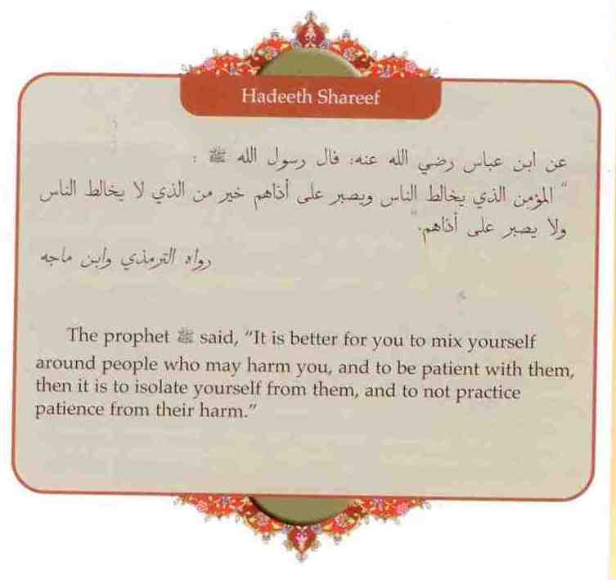

Slide 39
Selected Story
Abu Bakr And the slanderer
Once a person was verbally abusing Abu Bakr while the prophet(saas) was curiously watching with a smile. After taking much abuse quietly Abu Bakr responded to a few of his comments. At this, the prophet exhibited his disapproval, got up and left. Abu Bakr got up with the prophet and wandered, “o messenger of Allah, he was abusing me and you remained sitting. When I responded to him, you disapproved and got up”. The messenger of Allah responded , there was an angel with you responding to him. When you responded to him shaytan took his place. He then said, “o Abu Bakr, there are three solid truth’s. If a person is wronged and he acts patiently (without seeking revenge) just for the sake of Allah almighty, Allah will honor him and give him the upper hand with his help. If a person opens a door of giving gifts for commenting a relationship with relatives, Allah will give him abundance; and if a person opens a door of seeking charity for himself to increase his wealth, Allah will further reduce his wealth”.

Slide 40
Bilal Ibn Rabah
The hero who taught the world patience and persevrance
Bilal was an Abyssinian from the black race. His destiny made him a slave of some people were his mother was one of their slave girls. The prophet Muhammed( SAAS) made this slave Bilal a teacher to all humanity in the art of perseverance, faith and defending it what ever it takes. Refer for the details to the text book or any other Seerah book, to learn about Bilal’s firm faith, patience and trust in Allah. Finally Abu Bakr bought his liberty and made him free.

Slide 41
Study Questions
How does Patience affect your behavior towards others?
Explain how a Muslim should practice when loosing a loved one?
Explain how a Muslim should practice Sabr in times of illness?
Explain how a Muslim should practice Sabr loosing property?
Explain how a Muslim should practice Sabr in times of hunger.
Explain how a Muslim should practice Sabr when hurt by slander.

Slide 42
Exercise Related Texts
Indentify and write the du’aa’a Muslim should say asking Allah to help him/her when a calamity hits.
Indentify and write the Hadeeth narrated by Ibn Abbas on patience and perseverance.
Identify and write the Hadeeth on patience with others and tolerating their mistakes:
learn the circumstances that require patience and understand how to apply patience and perseverance in each situation.
How are you inspired by the story of Bilal’s sacrifice, patience and perseverance?

Slide 43
Key Content Summary
Patience when losing loved ones
Patience with property loss or damage
Patience during hunger or poverty
patience during illness
patience when facing injustice
patience with slander, hurtful words and the mistakes of others

